Slide 1

Final Presentation
Project Conceptualization and Development
Project Title: AR Turn Based-Card Game
Group: Martim Neves & José Santos
Practical assignment goal: Development of an AR turn-based game using targets as characters and AR elements to play the game
RVA
Notes:
Martim

Slide 2
Assignment 1
Project Conceptualization
Final Presentation - RVA 2021-2022
2
Notes:
Martim

Slide 3
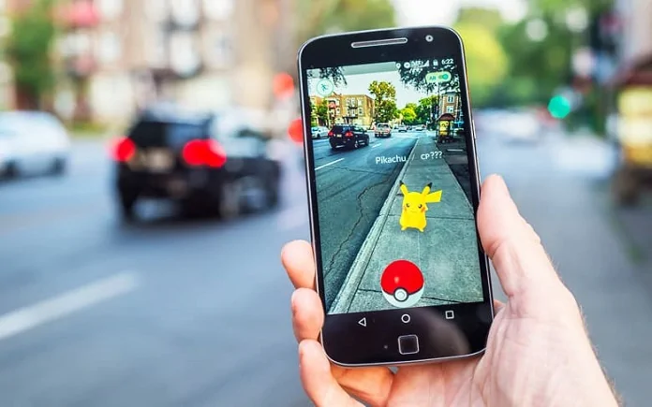
Introduction
AR Turn Based-Card Game
RVA Project
Why did we choose this project
Common interest (Games and AR)
Courses related:
VCI (EET)
CV (ECT)
https://cxocard.com/wp-content/uploads/2019/02/pokemon-go-augmented-reality.jpg
Final Presentation - RVA 2021-2022
3
Notes:
Martim

Slide 4


Personas
AR Turn Based-Card Game
John
Age 15-65
Spends his free time paying video games
Looks at this new game and thinks it might be fun
Jane
Age 15-65
Has an interest in VR and AR
Hears about a new AR game that she can play on her phone and decides to give it a try
Final Presentation - RVA 2021-2022
4
Notes:
Martim

Slide 5
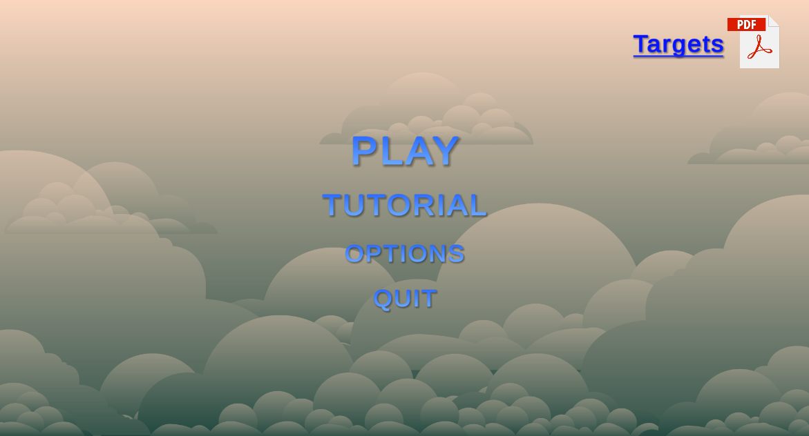
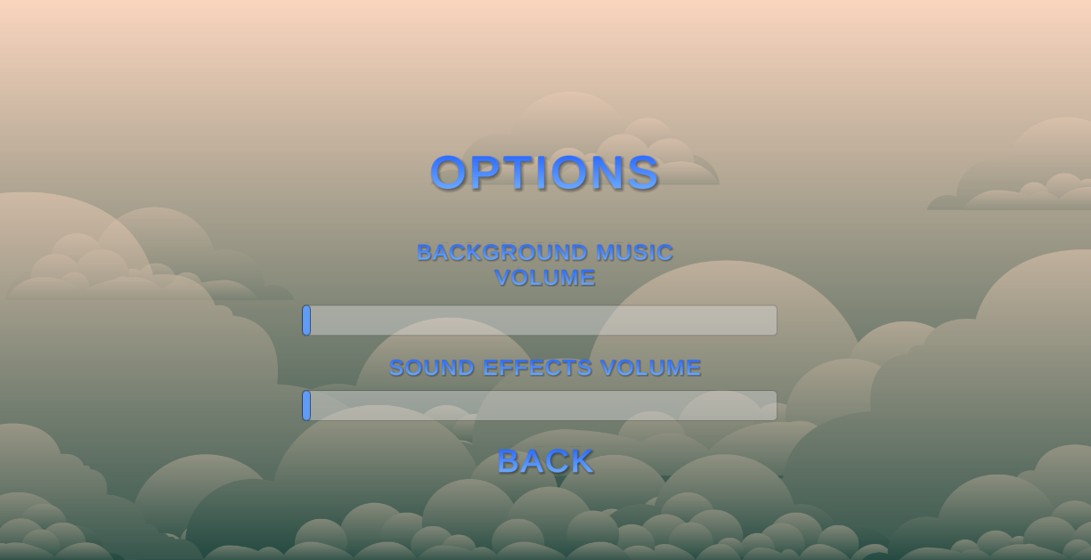
Storyboards (1/5)
AR Turn Based-Card Game
1
John decides to try the game
2
He is greeted with the game menu
Where he first goes to the options to turn up the music
3
Then he decides to Play the game
Final Presentation - RVA 2021-2022
5
Notes:
José

Slide 6
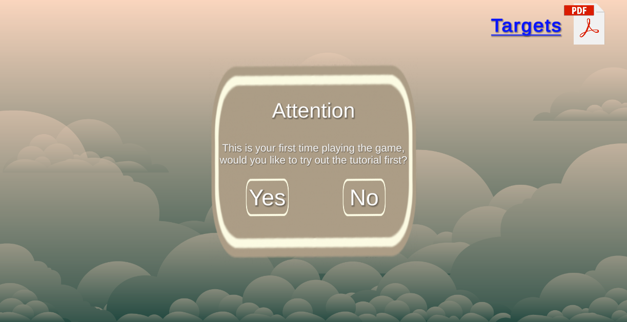
Storyboards (2/5)
AR Turn Based-Card Game
1
John is warned to try to play the tutorial first and so he does
Final Presentation - RVA 2021-2022
6
Notes:
José

Slide 7
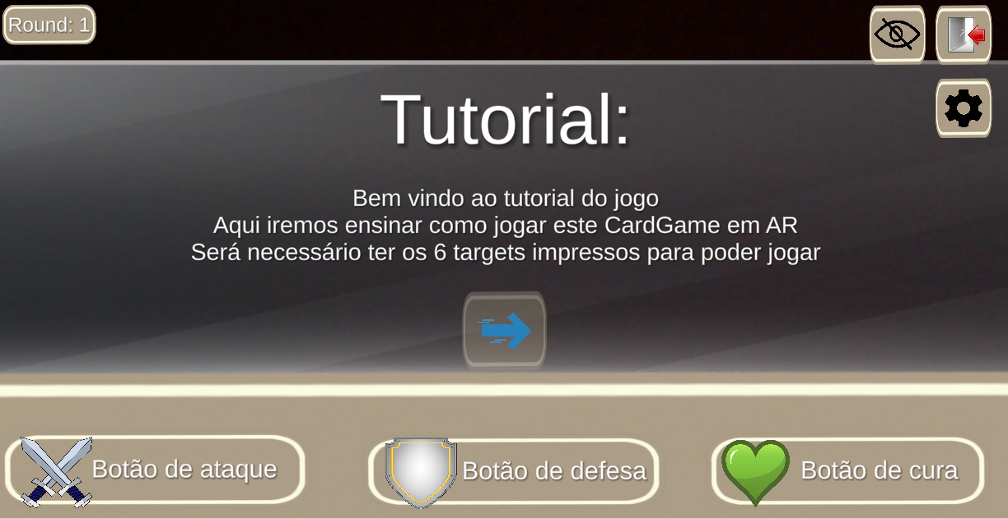
Storyboards (3/5)
AR Turn Based-Card Game
1
On the tutorial he is presented with informative text about the game.
2
In the End he goes straight to the main game
Final Presentation - RVA 2021-2022
7
Notes:
José

Slide 8
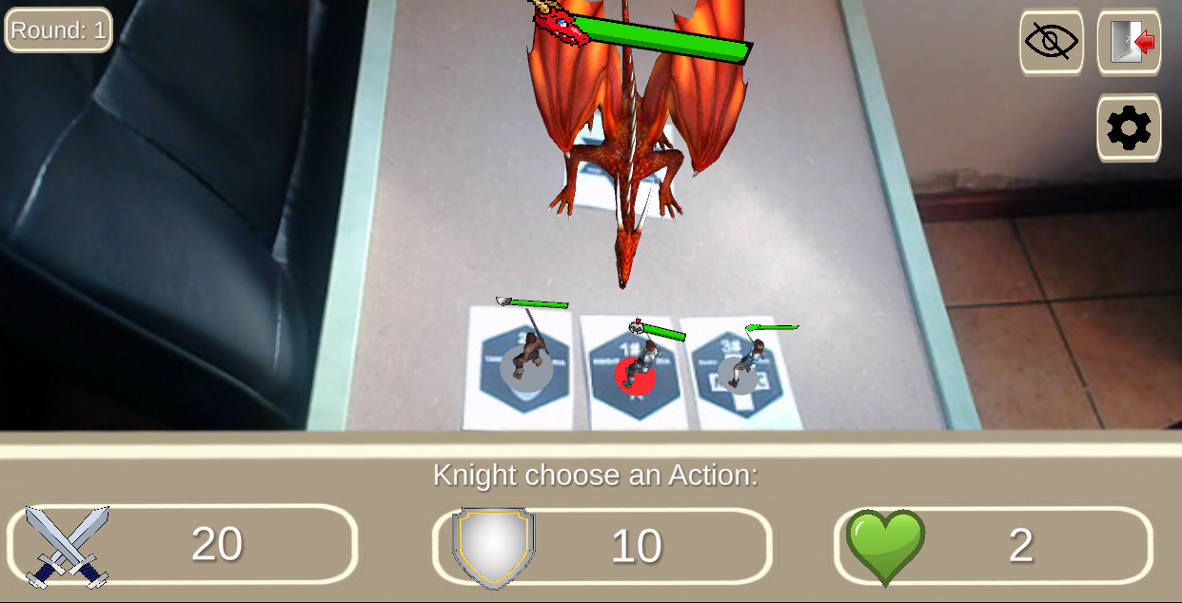
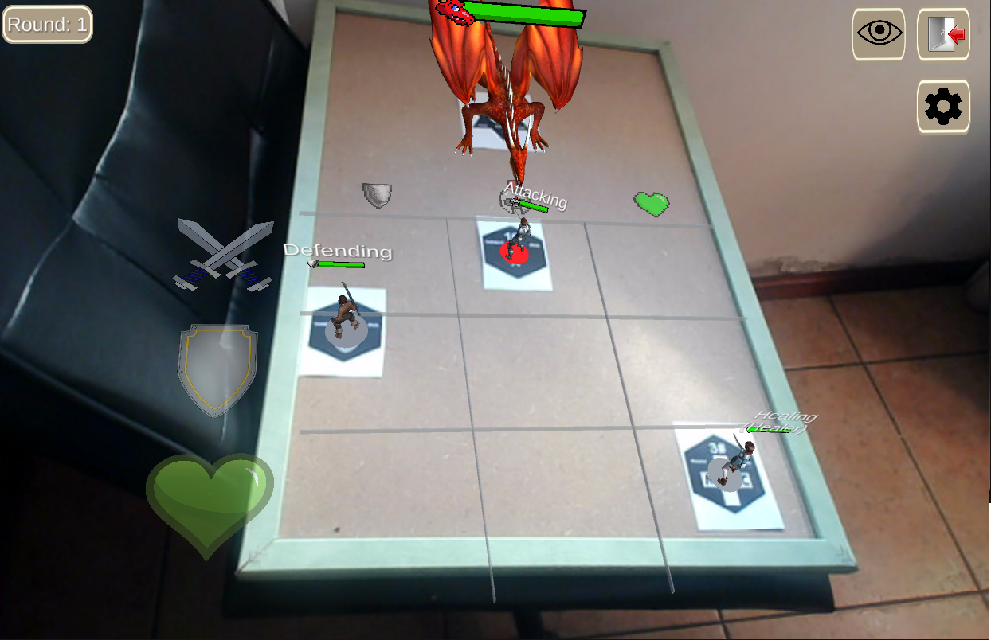
Storyboards (4/5)
AR Turn Based-Card Game
1
John decides to try out the simple game mode first where he only needs to use the on-screen buttons
2
After some rounds, he decides to try the AR Mode which he preferred
Final Presentation - RVA 2021-2022
8
Notes:
José

Slide 9
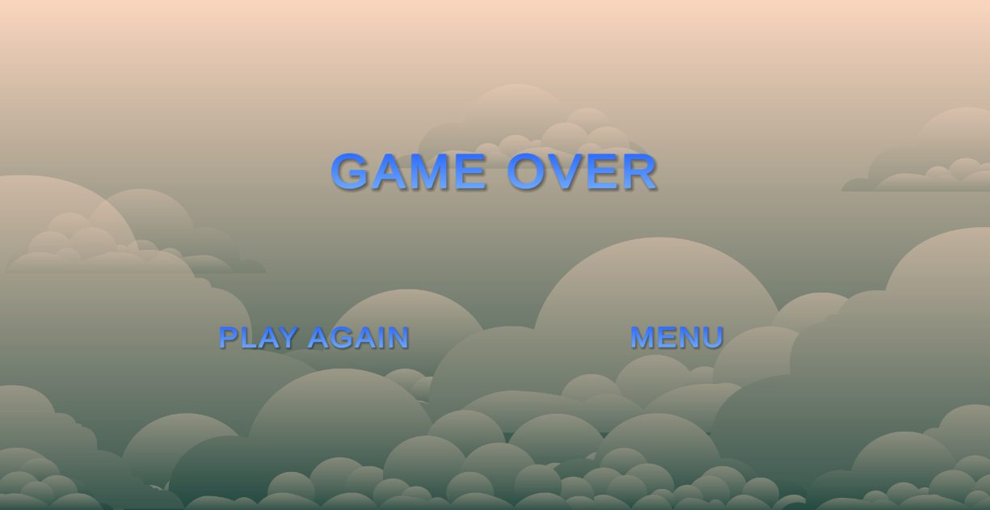

Storyboards (5/5)
AR Turn Based-Card Game
1
He lost his first game but on his second try he was able to beat it
Final Presentation - RVA 2021-2022
9
Notes:
José

Slide 10
Requirements
AR Turn Based-Card Game
Quality requirements – Fluid gameplay, working game mechanics, testability, accessibility
Functional Requirements – Identify and read the targets inside the playing area, perform actions to play the game (attack, defend or heal), see damage dealt and received, see character’s health and stats and send a notification when the game is over.
Final Presentation - RVA 2021-2022
10
Notes:
Martim

Slide 11
Project Constrains
AR Turn Based-Card Game
Creation of good targets
Lighting conditions have a major impact in the tracking
Getting the animations to work properly
Creation of a health bar system
Creation of a turn-based system
Make actions outside the playing area invalid
Final Presentation - RVA 2021-2022
11
Notes:
Martim

Slide 12
Assignment 2
Project Development
Final Presentation - RVA 2021-2022
12

Slide 13

Prototype Developed
AR Turn Based-Card Game
Integration between unity and Vuforia (AR)
Foundation of the Game
Game Modes:
Simple Mode
AR Mode
Animations, Audio and VFX
Final Presentation - RVA 2021-2022
13
Notes:
José

Slide 14
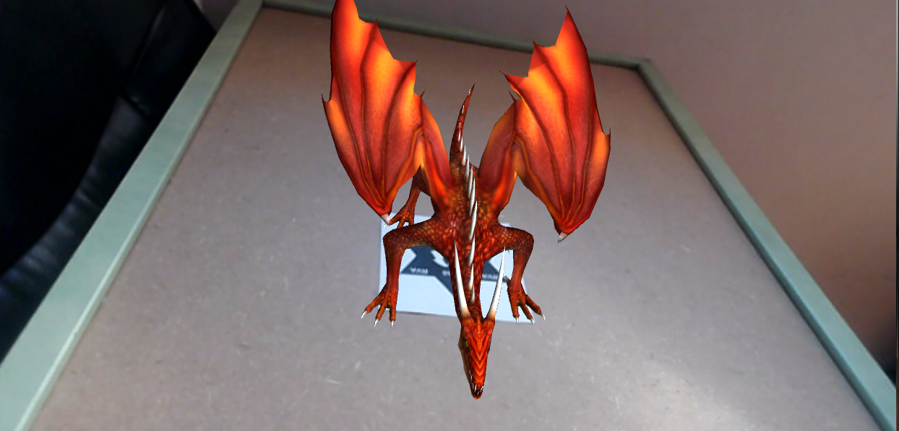
Prototype Developed
AR Turn Based-Card Game
Integration between unity and Vuforia (AR)
Final Presentation - RVA 2021-2022
14
Notes:
José

Slide 15
Prototype Developed
AR Turn Based-Card Game
Game Modes:
Simple Mode
AR Mode
Final Presentation - RVA 2021-2022
15
Notes:
José

Slide 16
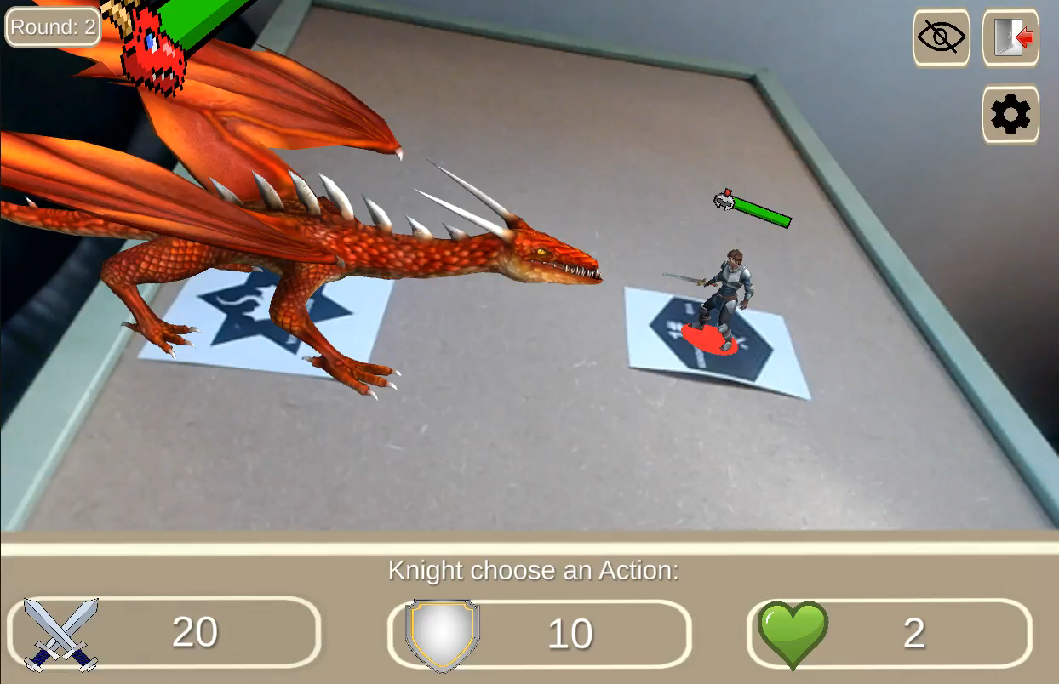
Prototype Developed
AR Turn Based-Card Game
Animations, Audio and VFX
Final Presentation - RVA 2021-2022
16
Notes:
Martim

Slide 17
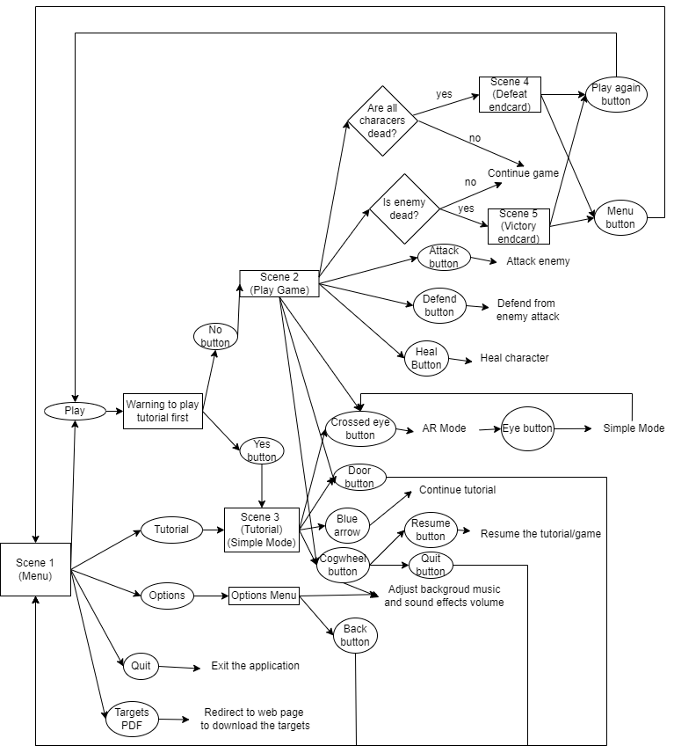
Project Structure
AR Turn Based-Card Game
Final Presentation - RVA 2021-2022
17
Notes:
Martim

Slide 18
Tools Used
AR Turn Based-Card Game
Game Engine: Unity Ver 2020.3.23f1
AR engine: Vuforia Ver 10.3.2
Free 3D Models obtained from Unity Asset store:
https://assetstore.unity.com/packages/3d/characters/medieval-cartoon-warriors-90079
https://assetstore.unity.com/packages/3d/characters/creatures/dragon-for-boss-monster-hp-79398
https://assetstore.unity.com/packages/essentials/tutorial-projects/unity-particle-pack-127325
Hardware:
10’ Android Tablet (for testing)
Mobile Android Phone (for testing)
Mechanical arm to support the device mid Air for better comfort
Final Presentation - RVA 2021-2022
18
Notes:
Martim

Slide 19
User Evaluation
AR Turn Based-Card Game
Within Subjects Method (Everyone tries both game modes)
Investigate which game mode was better and the general feeling of the game
John (Age 15-65, Likes video games) and Jane (Age 15-65, Likes AR and VR)
Perform the Tutorial, Start with one of the two game modes (Random)
8 Participants (5 male and 3 female between the ages of 19 and 51)
What questionnaires where used?
Questionnaire for User Interaction Satisfaction (QUIS)
A set of open-ended questions specific to the game
Final Presentation - RVA 2021-2022
19
Notes:
José

Slide 20
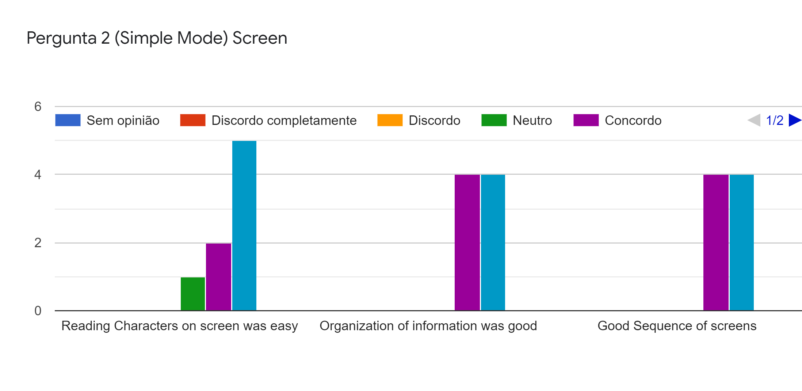
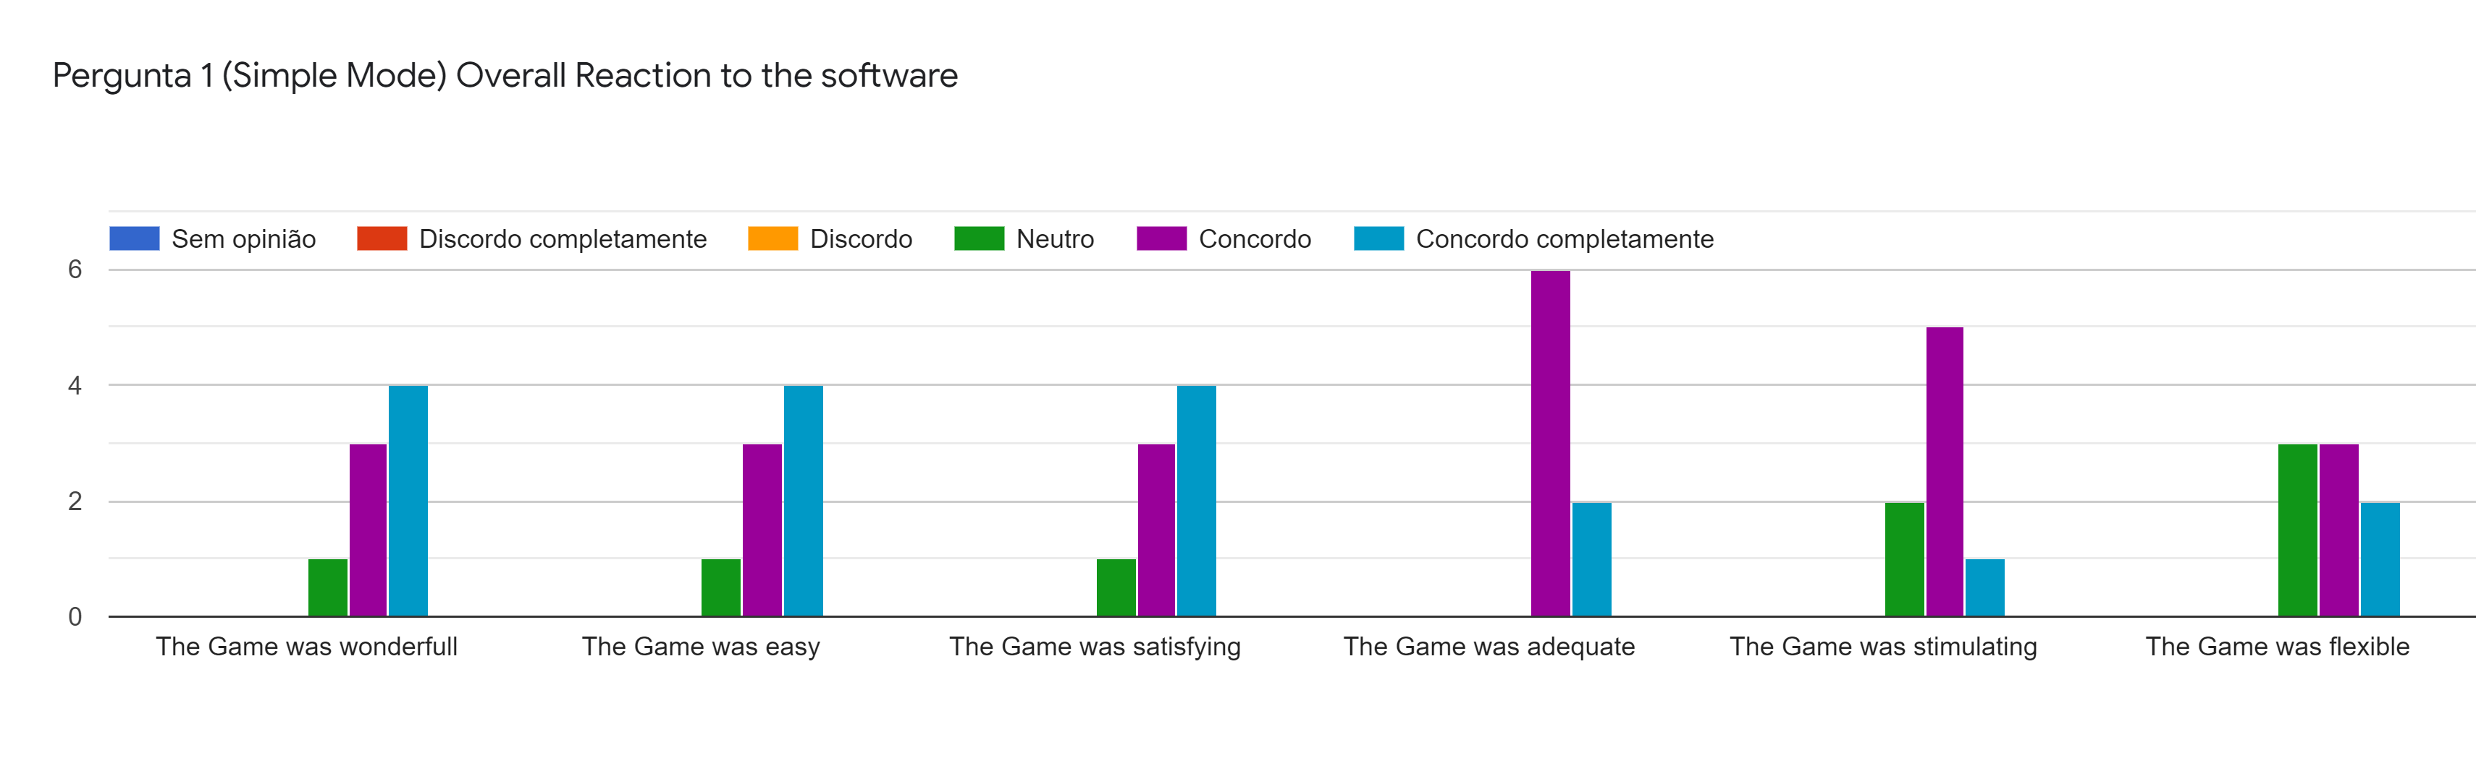
User Evaluation
AR Turn Based-Card Game
Main Results (Simple Mode):
Final Presentation - RVA 2021-2022
20
Notes:
José

Slide 21
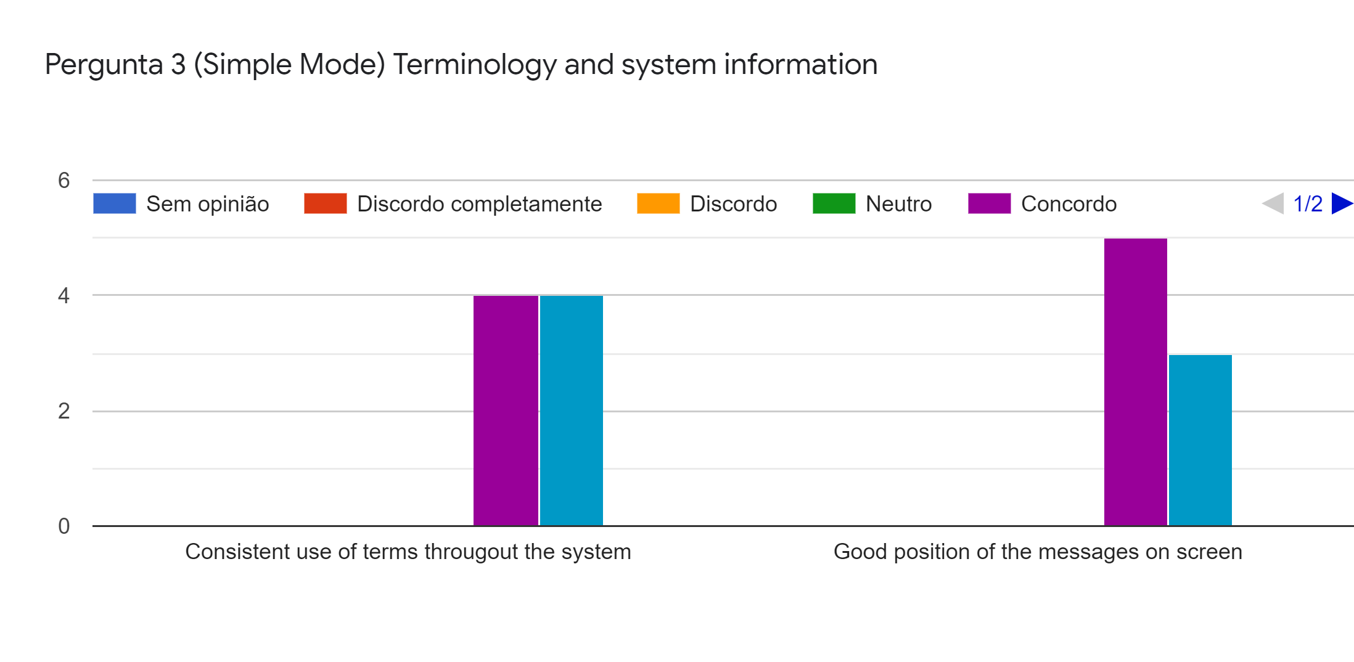
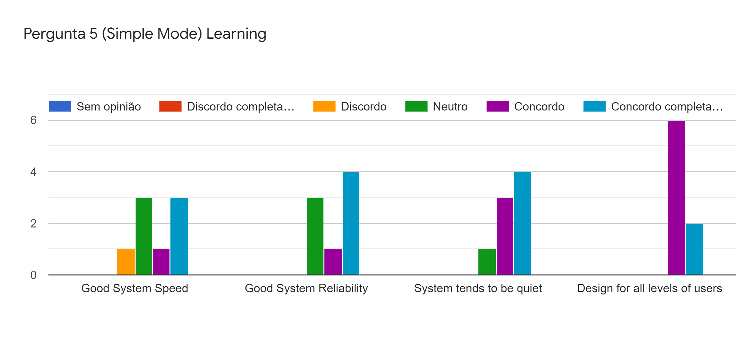
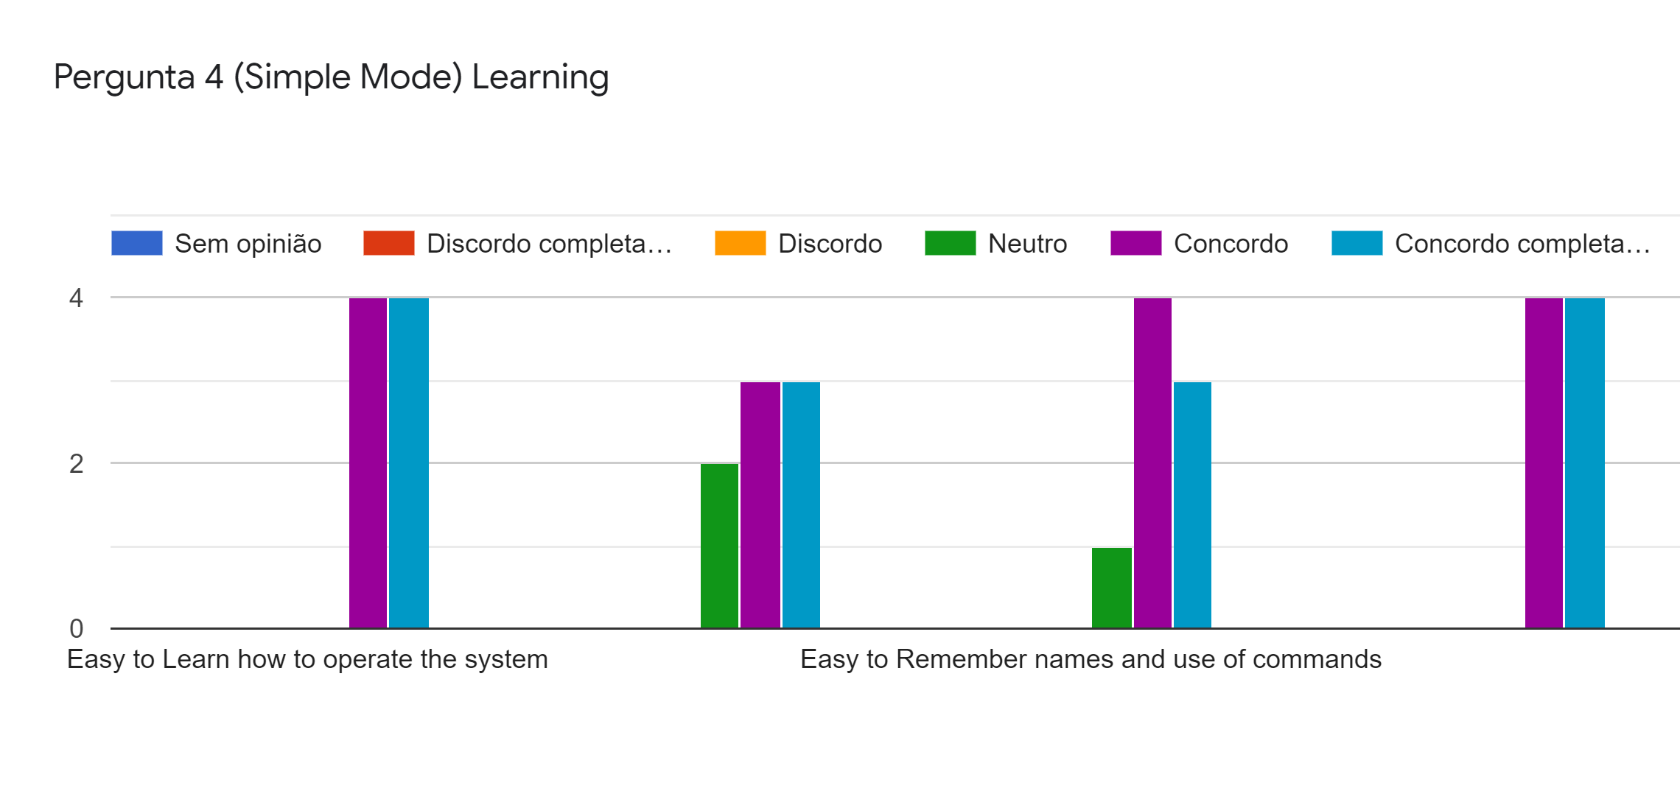
User Evaluation
AR Turn Based-Card Game
Main Results (Simple Mode):
Fun to Explore new features by trial and error
Perform tasks is straightforward
Final Presentation - RVA 2021-2022
21
Notes:
José

Slide 22
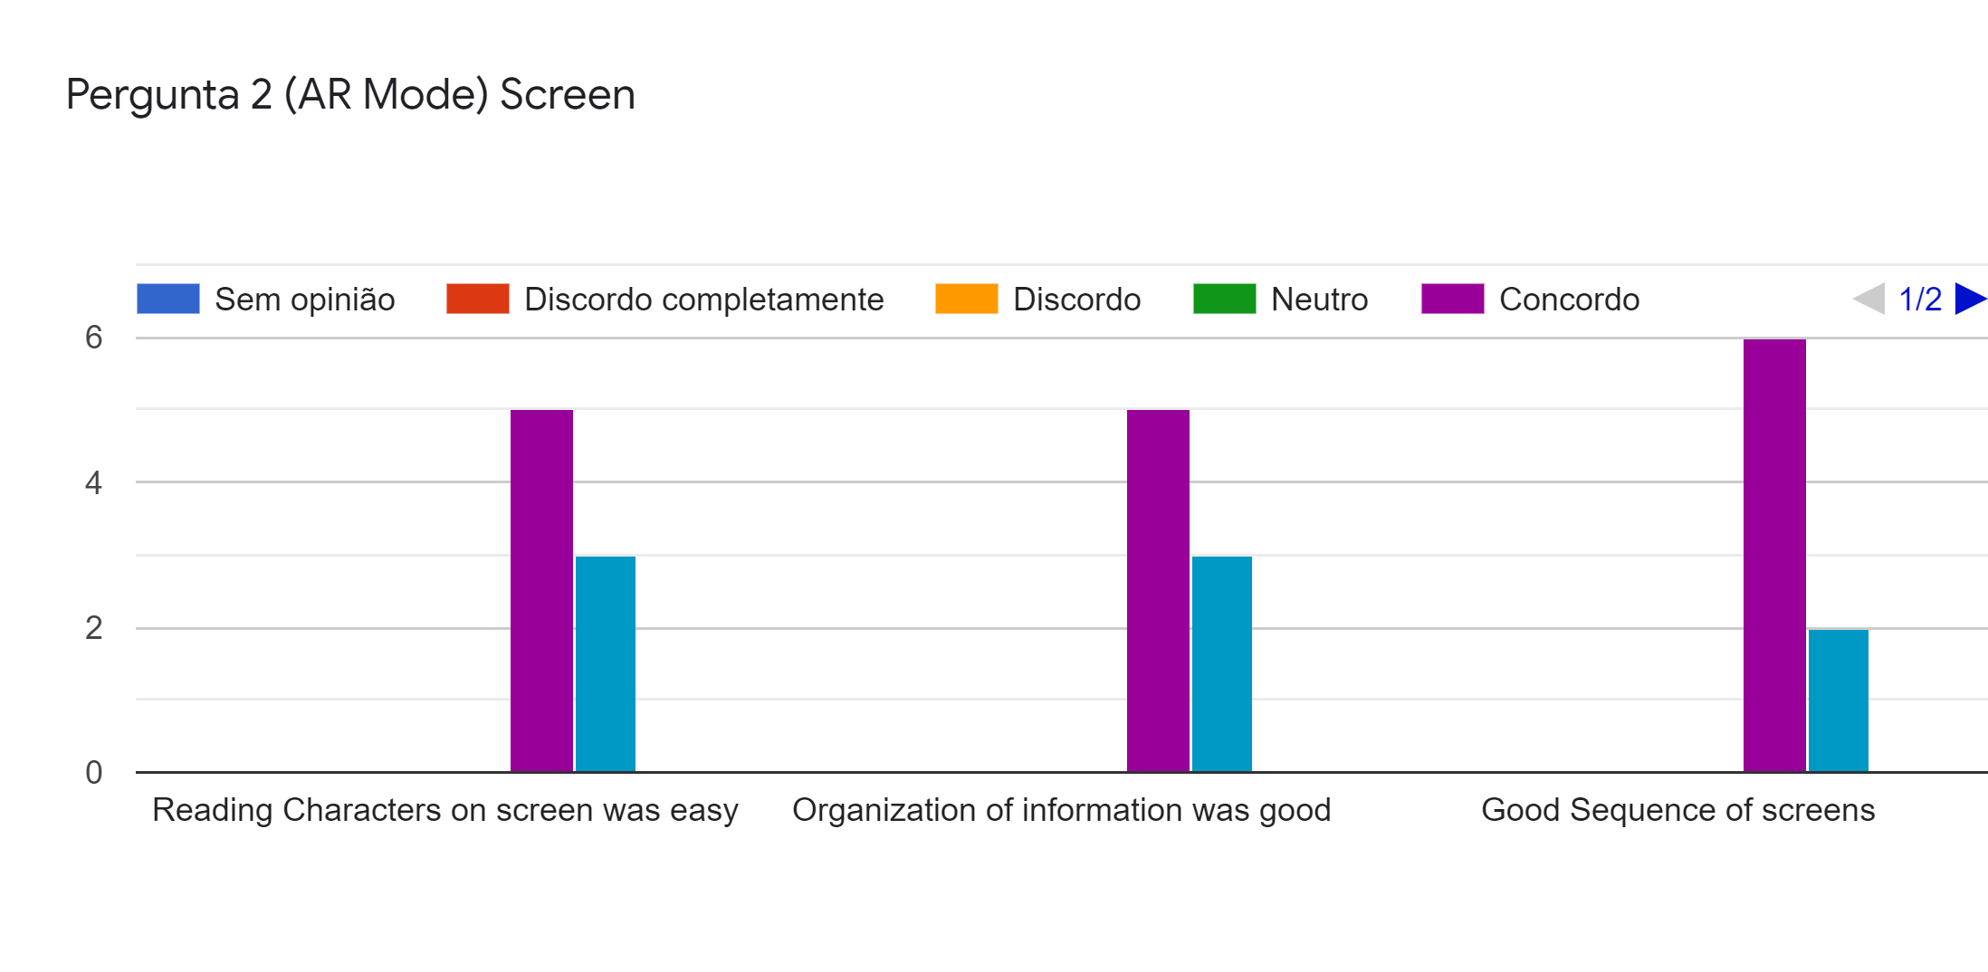
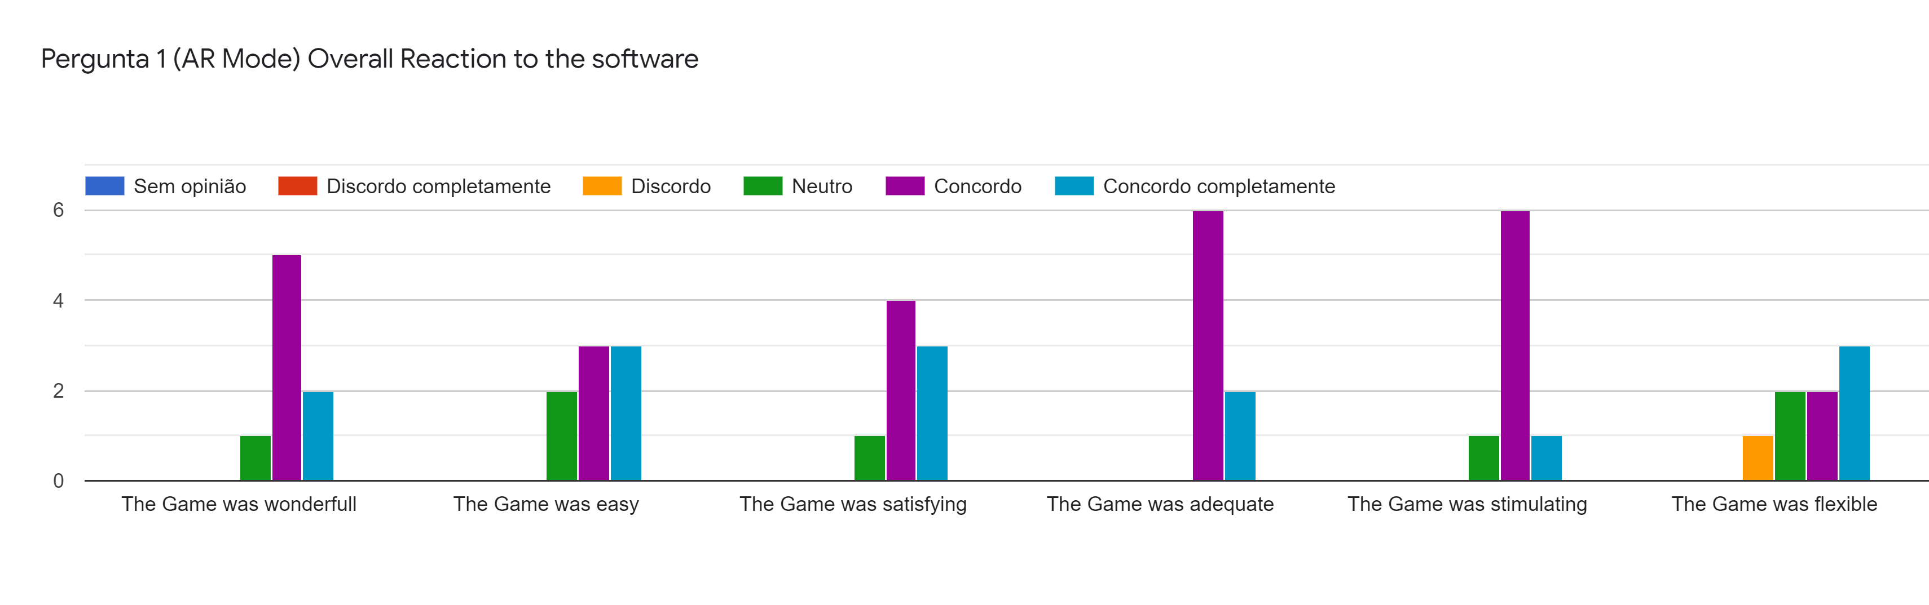
User Evaluation
AR Turn Based-Card Game
Main Results (AR Mode):
Final Presentation - RVA 2021-2022
22
Notes:
José

Slide 23
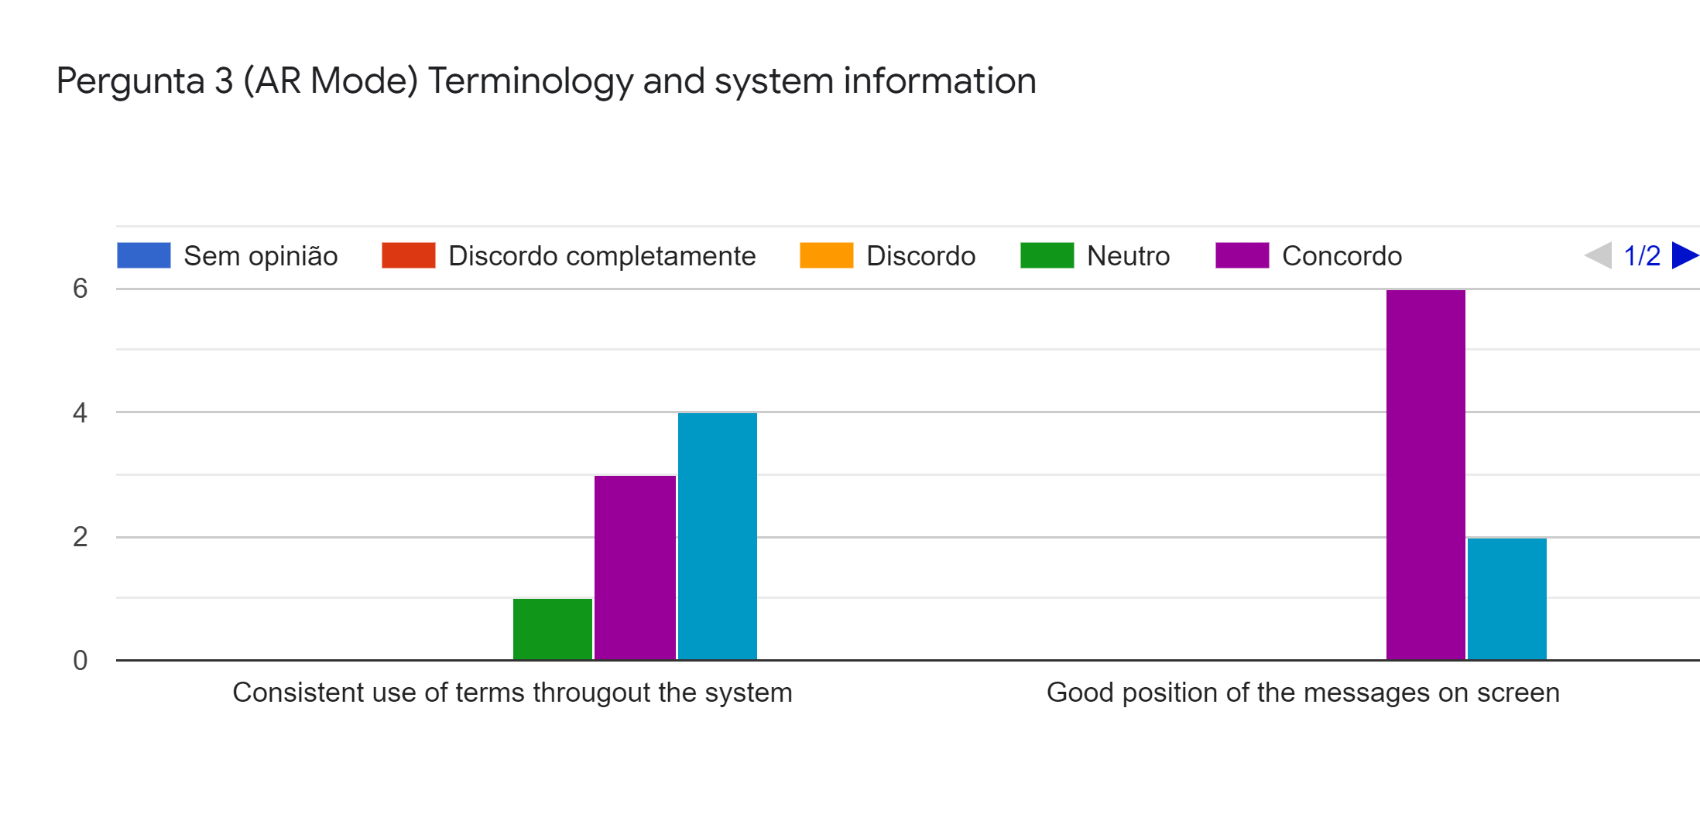
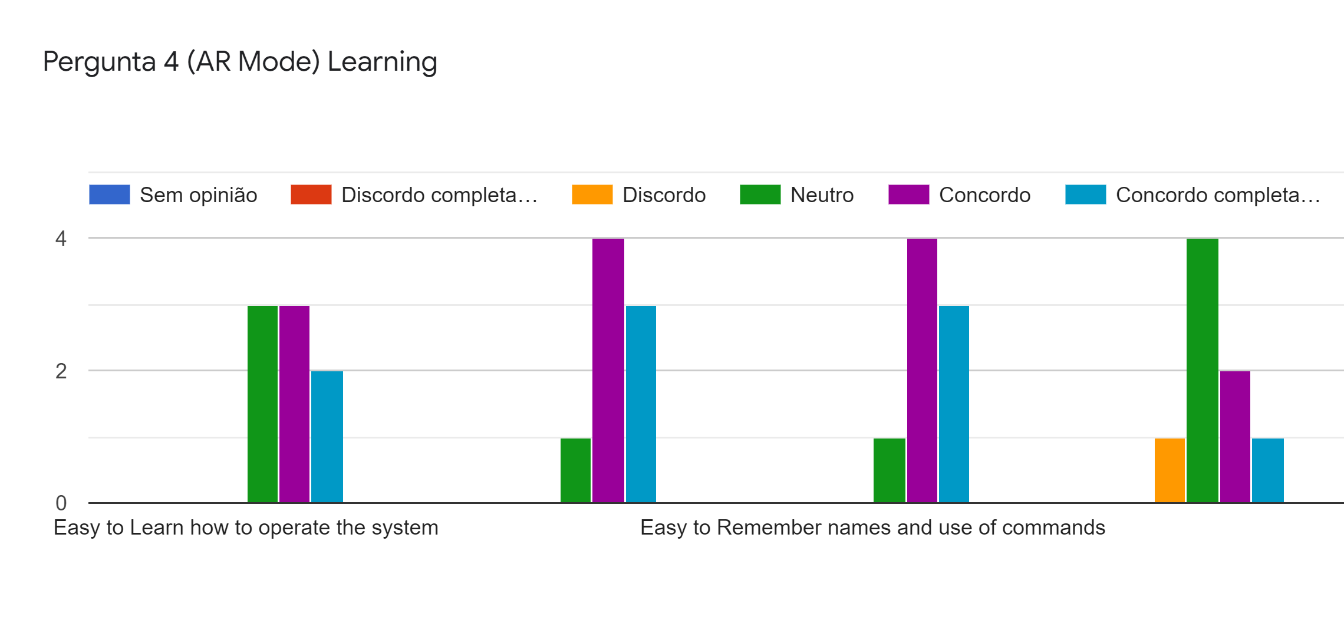
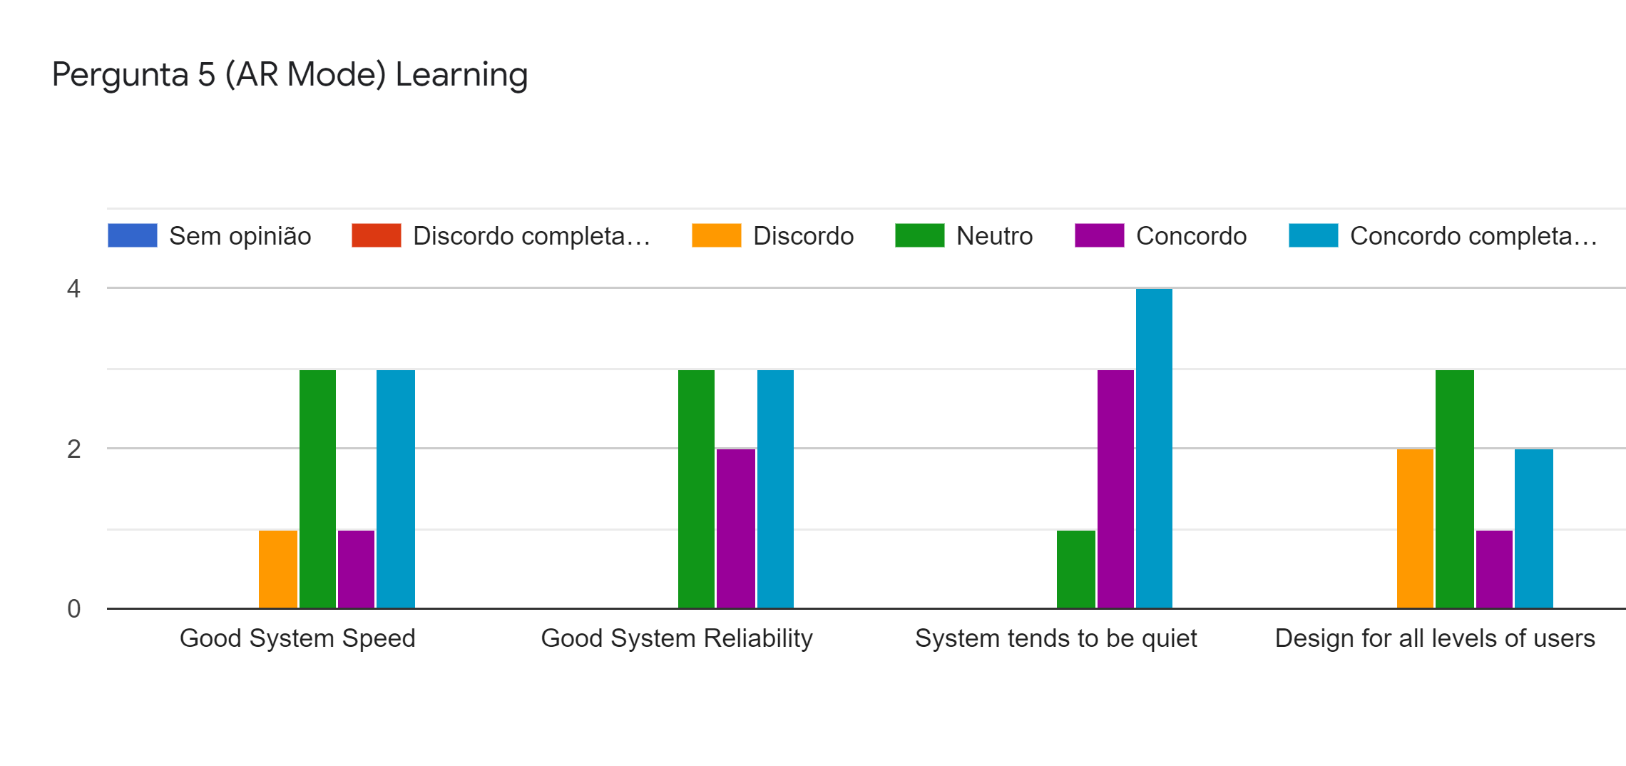
User Evaluation
AR Turn Based-Card Game
Main Results (AR Mode):
Fun to Explore new features by trial and error
Perform tasks is straightforward
Final Presentation - RVA 2021-2022
23
Notes:
José

Slide 24
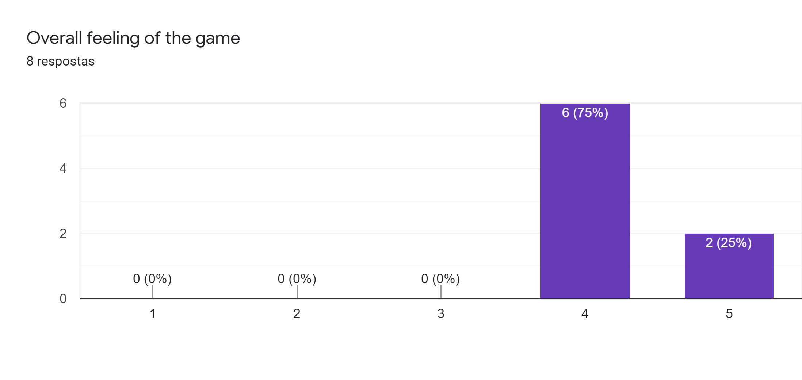
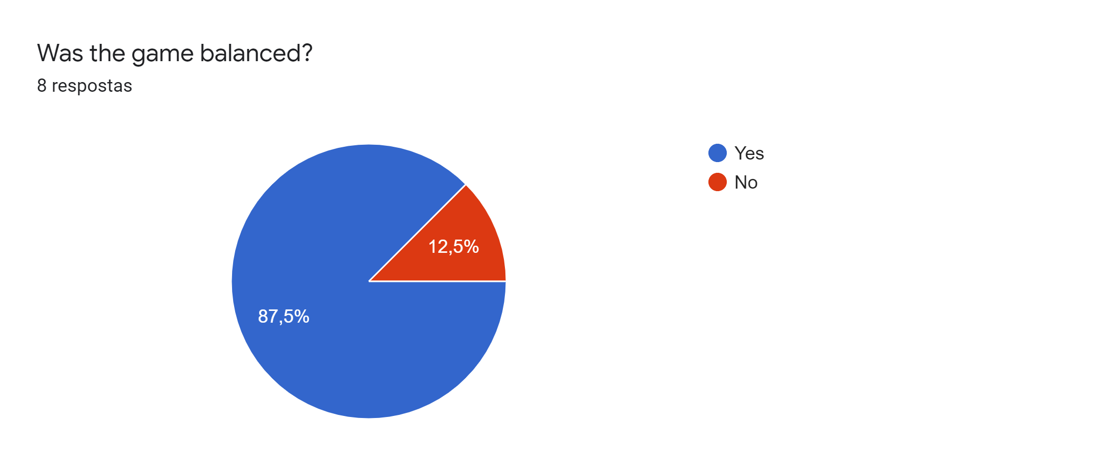
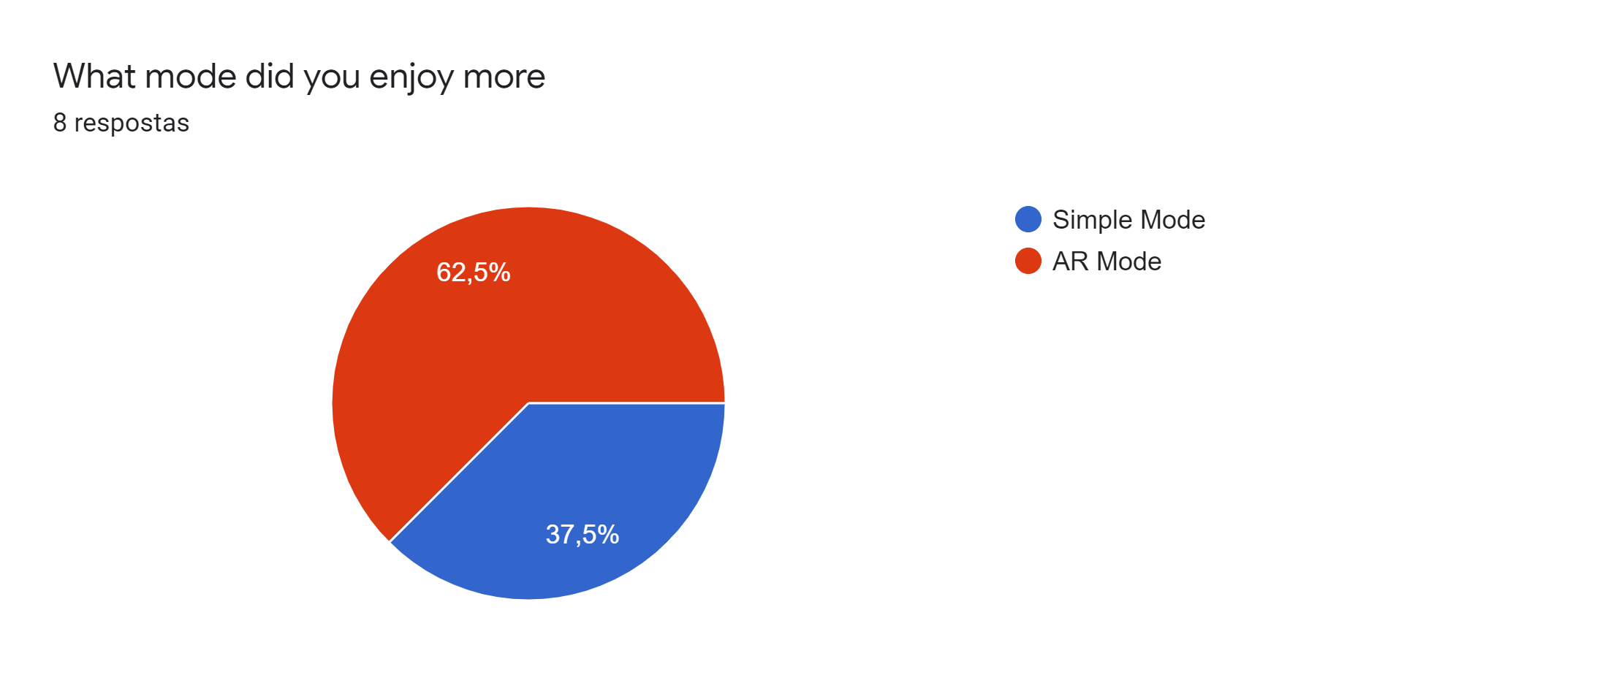
User Evaluation
AR Turn Based-Card Game
Main Results (Open ended Questions):
Simple Mode easier to understand and play
AR Mode was more fun and more engaging
Change stats
Add mechanics
Final Presentation - RVA 2021-2022
24
Notes:
José

Slide 25
User Evaluation
AR Turn Based-Card Game
Main Results (Open ended Questions):
Likes:
Simple game system
Animations
Real time tracking and gameplay
Dislikes:
Complexity of AR Mode
Slow on some devices
Character low mobility
Improvements:
Make the AR Mode simpler
Add more levels
Add more instructions
Add more mechanics
Final Presentation - RVA 2021-2022
25
Notes:
José

Slide 26
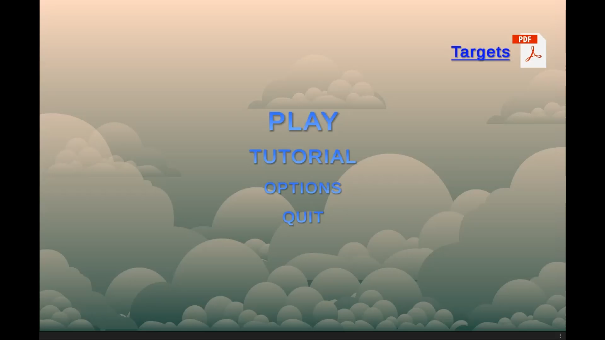
Demo Video (Main Menu & Simple Mode)
AR Turn Based-Card Game
Final Presentation - RVA 2021-2022
26
Notes:
José

Slide 27
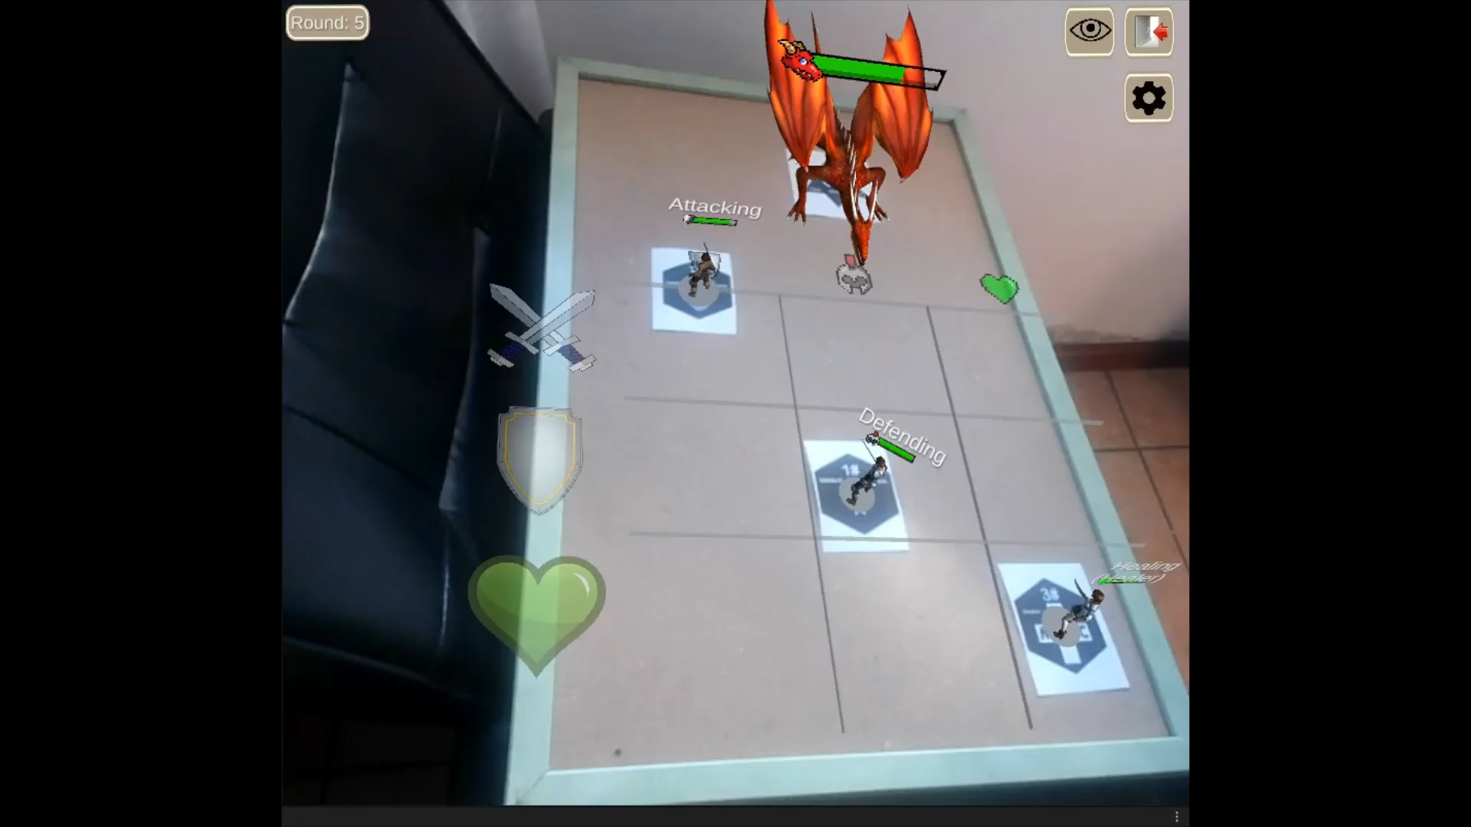
Demo Video (AR Mode)
AR Turn Based-Card Game
Final Presentation - RVA 2021-2022
27
Notes:
José

Slide 28
Expectation vs Reality - Project Objectives
AR Turn Based-Card Game
What goals we achieved:
Learn how to work with Unity and AR(Vuforia)
Choose adequate targets and character models (within the resources available)
Build a fluid and clean game logic
Make the most use of AR to play the game
Final Presentation - RVA 2021-2022
28
Notes:
Martim

Slide 29
Main difficulties
AR Turn Based-Card Game
Creation of good targets
Finding good Assets for the characters (with animations)
Lighting conditions have a major impact in the tracking
Getting the animations to work properly (Timing)
Creation of a turn-based system (Exponential complexity)
Make actions outside the player turn invalid
Final Presentation - RVA 2021-2022
29
Notes:
Martim

Slide 30
Future work
AR Turn Based-Card Game
Port to Hololens (future objective)
Create several levels (future objective)
Implement multiplayer (future objective)
Final Presentation - RVA 2021-2022
30
Notes:
Martim

